Slide 1
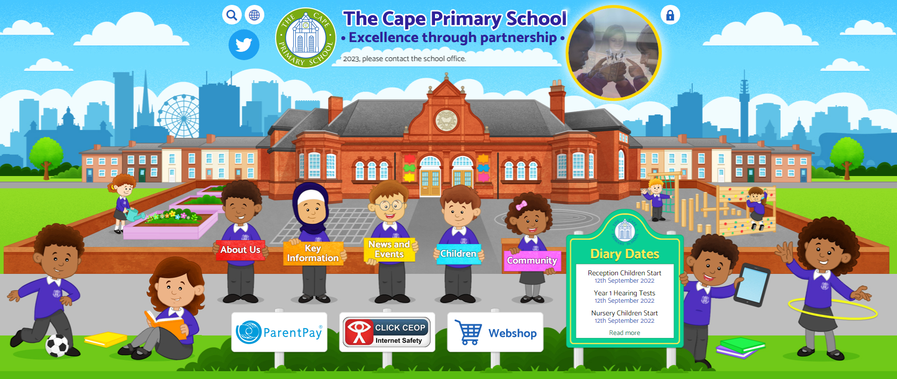
Welcome
Year 6 meeting

Slide 2


Excellence Through Partnership
Our home-school agreement.
This is our pledge to you and your pledge to support your child at home.
Please sign your home-school agreement and return to school.
2025-26

Slide 3

Ways you can help at home this year…
In the 2026/27 academic year, you can help at home by:
Ensuring your child goes onto TT Rockstars, SPaG.com and Reading Plus.
Read with your child or listen to them read on a regular basis.
Make sure your child is on time every day!
Making sure your child comes to school dressed appropriately on PE days.
Make sure your child is dressed appropriately for school (NO TRAINERS or other casual wear). This includes jewellery (religious jewellery is acceptable).
Keep up to date with events detailed on the school website.

Slide 4

Mathletics is a targeted, rewarding and captivating online learning resource, aligned with the curriculum and is an intervention used in school to help your child.
Some children have been identified by their teacher as needing additional Maths practice.
The extra Mathletics practice at home can make all the difference to your child’s progress.
Mrs Squire and Miss Cridge will meet with you at Friday 2nd October 2.45pm to explain more!

Slide 5

Important Days…
Days to remember:
We do PE on Thursdays, some children will be going
swimming and have been contacted about this.
This will change in Spring term but we will communicate this to your children and on the website.
Important dates this term:
22nd October Learning Together Day
23rd October INSET day – school closed to children
26th October—30th October half term
31st October-Deadline for secondary school applications
^{21st} December—break up at 1.30pm for Christmas holidays
Return on Tuesday 5th January
Trips and Visits:
We will be arranging a trip in the Spring term

Slide 6

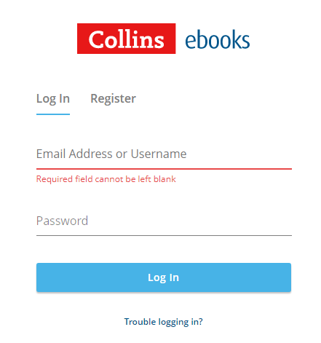


Reading at home…
Reading isn’t just for school. Did you know listening to your child read at home can dramatically improve reading skills which means they will be able to access books and their learning. This raises standards and improves your child’s chances in life. In the UK only 37% of children read with their family every day. Let’s ensure every child reads at home every day.
If you would like a guide to helping your child read at home then please let the teacher know and we will get a guide printed in your home language.

Slide 7
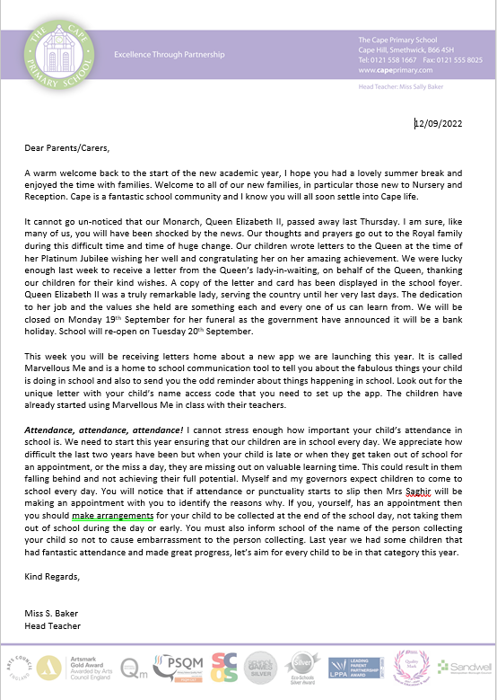



Things to help you…
There are lots of different ways of finding out what is happening in school:
Our website www.capeprimary.com
Letters
Texts
If you would like to buy uniform please buy online from the webshop on the school website.

Slide 8
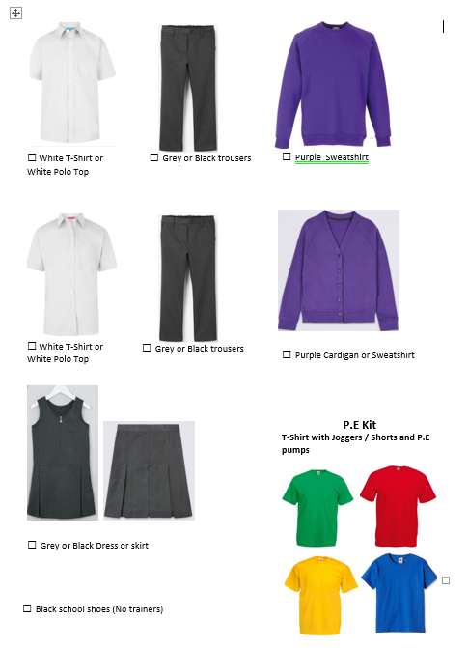
Our Uniform…
Our school uniform consists of:
A purple jumper or cardigan, jumpers with logos are available from the school web shop but are not mandatory.
Grey or black trousers or shorts, skirt or dress.
A lilac summer dress can be worn.
White shirt or T-shirt.
School tie – optional.
P.E kit - a white T-shirt, leggings/jogging bottoms or shorts.
Some children may choose to wear a head scarf for religious reasons this should be black or purple in colour.
Earrings should only be studs and removed for P.E/Swimming.
Black shoes or trainers – please avoid branded trainers with different coloured markings.
You can purchase our uniform:
By accessing the web shop from the home page of our website. Once the order is placed then the school office will give the item to your child to bring home.
www.capeprimary.com scroll to the bottom and you should find this icon. Please click onto it and place your order.
Most high street supermarkets will stock the purple school jumper, school trousers/shorts/dresses/skirts.
We have introduced a second hand uniform shop in school. Please speak to the school office about purchasing second hand uniform.

Slide 9
What to do if my child or I am worried about something…
The first thing to do is always talk to your child’s class teacher. Nine times out of ten things can be sorted straight away by a quiet word with the teacher.
You can speak to your child’s teacher at the end of the day, but please make sure you wait patiently until the teacher has dismissed the class, that way you will get the teacher’s full attention.
If you require a more detailed discussion with the class teacher then please arrange to book an appointment. We will do our best to arrange an appointment as swiftly as possible.
Please do not ring to speak to a teacher during the day – they are busy teaching your child!
It can also be difficult to talk to the teacher first thing in the morning because the children go straight to class. The staff on the gate will do their best to get a message to the teacher.
Our Family Support Workers, Kelly and Michelle are available to discuss any concerns or worries that are not related to learning.
We are all here to help and support your child

